Slide 1
Open Source Software Engineering
SE ZG587
Kumar Manish
21 Oct, 2023

Slide 2
Session 12 : Git and GitHub....

Slide 3
GitHub Products and Accounts

Slide 4
GitHub’s Products
GitHub offers Free and Paid products for storing and collaborating on code. Some products apply only to personal accounts, while other plans apply only to organization and enterprise accounts.
Git Hub Accounts allow you to organize and control access to that code. There are three types of accounts on GitHub.
  Personal accounts :Every person who uses GitHub signs into a personal account.
  Organization accounts : An organization account enhances collaboration between multiple personal accounts.
  Enterprise accounts: An enterprise account allows central management of multiple organizations.

Slide 5
Personal Account
Each Personal account uses either GitHub Free or GitHub Pro.
All personal accounts can own an unlimited number of public and private repositories, with an unlimited number of collaborators on those repositories.
If you use GitHub Free, private repositories owned by your personal account have a limited feature set.
You can upgrade to GitHub Pro to get a full feature set for private repositories.
Most people will use one personal account for all their work on GitHub.com, including both open source projects and paid employment.
If you're currently using more than one personal account that you created for yourself, recommended to combine the accounts.

Slide 6
Organization accounts
All organizations can own an unlimited number of public and private repositories.
Organizations are shared accounts where an unlimited number of people can collaborate across many projects at once.
You can use organizations for free, with GitHub Free, which includes limited features on private repositories.
To get the full feature set on private repositories and additional features at the organization level, including SAML single sign-on and improved support coverage, you can upgrade to GitHub Team or GitHub Enterprise Cloud.
Like personal accounts, organizations can own Resources such as repositories, packages, and projects. However, you cannot sign into an organization.
Instead, each person signs into their own personal account, and any actions the person takes on organization resources are attributed to their personal account.

Slide 7
Organisation account
Each personal account can be a member of multiple organizations.
The personal accounts within an organization can be given different roles in the organization, which grant different levels of access to the organization and its data.
All members can collaborate with each other in repositories and projects, but only organization owners and security managers can manage the settings for the organization and control access to the organization's data with sophisticated security and administrative features.
You can also create nested sub-groups of organization members called teams, to reflect your group's structure and simplify access management.

Slide 8
Enterprise accounts
GitHub Enterprise Cloud and GitHub Enterprise Server include enterprise accounts, which allow administrators to centrally manage policy and billing for multiple organizations and enable inner sourcing between the organizations.
Your enterprise account on GitHub.com allows you to manage multiple organizations.
Your enterprise account must have a handle, like an organization or user account on GitHub.
  Organizations are shared accounts where enterprise members can collaborate across many projects at once.
  Organization owners can manage access to the organization's data and projects with sophisticated security and administrative features.

Slide 9
Enterprise accounts
Administrators for the enterprise account
Billing and usage (services on GitHub.com, GitHub Advanced Security, user licenses)
Security (single sign-on, IP allow lists, SSH certificate authorities, two-factor authentication)
Enterprise policies for organizations owned by the enterprise account

Slide 10
Best practices for enterprises
Use human-readable usernames
Avoid extensive collaboration in user-owned repositories
Minimize the number of organizations
Use policies
Identify the best authentication method for your enterprise
Assign multiple owners

Slide 11
GitHub Essentials
Repository : Creating , forking , cloning
Branches
Commits
Pull Requests

Slide 12
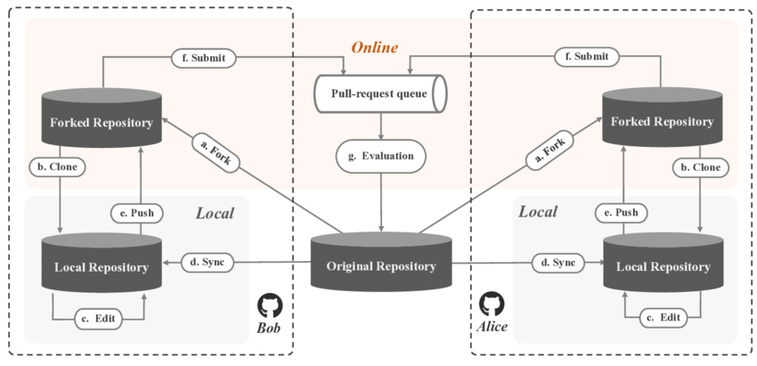
Workflow of Pull Development model

Slide 13
GitHub essentials : Repository
A GitHub repository can be used to store a development project.
It can contain folders and any type of files (HTML, CSS, JavaScript, Documents, Data, Images).
A GitHub repository should also include a license file and a README file about the project.
A GitHub repository can also be used to store ideas, or any resources that you want to share.
A project repository helps in managing project work ; it also helps in executing collaborative engagements and discussions over the project.
Individual as well as shared ownership (with other people in an organisations ) of the repository is also possible.
Repository’s visibility used to restrict access to the repository – PUBLIC/ PRIVATE

Slide 14
Creating a Repository
One can create a new repository on a personal account or an organisation’s account (with sufficient permission )
For this, navigate to the upper –right corner of the home page of your GitHub account page and use the drop down menu , and select New repository
Type a name for your repository , and an optional description
Choose a repository visibility – set it to public
Choose a license
Click Create Repository

Slide 15
Forking a Repo
In order to contribute to a repo created by someone else , the first step will be to fork that repo in to account
Typically , most of the repositories are configured so that others (non owners) are not allowed to directly “Push” changes to them.
Instead, one need to request the administrator of the repository to “pull” the proposed changes from the online repositor in to the main repository .
In order to do this , it is necessary for you to have a version of the repo on GitHub from where the admin can pull the changes proposed by you.
Hence , forking a repo is generally the first step that is executed in order to make a copy of the current state of the repo and associate that copy with your account.

Slide 16
How to fork a repo ?
Login into your account on GitHub.
Navigate to the repo you wish to contribute to.
Use the fork option to fork a repo.
Once completed , a writable copy of this repo will be created in your GitHub account.
This process will NOT bring about any changes in your local computer.

Slide 17
Cloning a Repo
One can clone a GitHub repository (hosted online ) and create a local copy of the same on to the local system
Cloning a repository brings down a complete copy of the repository data that GitHub has at that point in time , including all version of every files and folder for the project
One can now make changes to this local repo, commit them and later push them back to the forked repo on GitHub

Slide 18
Commit changes to Repo
This helps to save the changes that you would make to your local repository
Commit will not cause any changes to be made to your remote repository on GitHub

Slide 19
GitHub essentials : Branch
A GitHub branch is used to work with different versions of a repository at the same time.
By default a repository has a master branch (a production branch).
Any other branch is a copy of the master branch (as it was at a point in time).
New Branches are for bug fixes and feature work separate from the master branch.
When changes are ready, they can be merged into the master branch. If you make changes to the master branch while working on a new branch, these updates can be pulled in.

Slide 20
GitHub essentials : Commits
Commits : At GitHub, changes are called commits. Each commit (change) has a description explaining why a change was made.
Pull Requests : Pull Requests are the heart of GitHub collaboration.
With a pull request you are proposing that your changes should be merged (pulled in) with the master.
Pull requests show content differences, changes, additions, and subtractions in colors (green and red).
As soon as you have a commit, you can open a pull request and start a discussion, even before the code is finished.

Slide 21
What is a Pull request ?
Pull requests are used to inform others about the changes that you have made to your repository on GitHub
After opening a Pull request , one can carry out discussions over the proposed changes with the owner of the open-source project and other collaboration as well.
All can review the proposed and add follow –up commits before merging the changes in to the base branch

Slide 22
Merging or closing a Pull Request
By default , any pull request can be merged at any time (if there does not exist any conflict ).
In case of conflict, it is the responsibility of the project owner to manually resolve the conflict and then merge the changes.

Slide 23
Push changes to GitHub
One must push the changes that have been committed in the Local Repo on to the Remote Repo on GitHub

Slide 24
Assignments :
Understanding Open-source project , submit on anyone from following lists :
Moodle :
    https://moodle.org
  Introduction and history
  Managing a Moodle site
  Managing a Moodle course
  Managing content
Linux Project :
    https://www.linux.org/
    https://www.linux.com/
    https://www.linuxfoundation.org/projects/hosting
  Introduction and History of movement
  Linux Shell, and file structures
  Security : Encryption, Integrity checks and signatures
  Linus Desktop : GNOME , KDE
Kubernetes Project :
    https://kubernetes.io/
  Introduction and history of movement
  Kubernetes Components & Architecture
  Kubernetes API, Kubernetes Objects, Pods
Eclipse Project
    https://www.eclipse.org/
  Introduction and History of movement
  Installation and explore windows, explore menus views,
  Perspective and workspaces
Drupal
https://www.drupal.org/
  History
  Core Modules, themes, localization
  Extending the core
  Architecture
LibreOffice
  https://www.libreoffice.org/
  Introduction, History, Features
  LirbreOffice Technology
  Modules
  Challenges and Future of Libreoffice

